Slide 1

Polymorphism in Python

Slide 2

Objectives
Polymorphism
Examine polymorphism
Discuss how polymorphism relates to Python

Slide 3
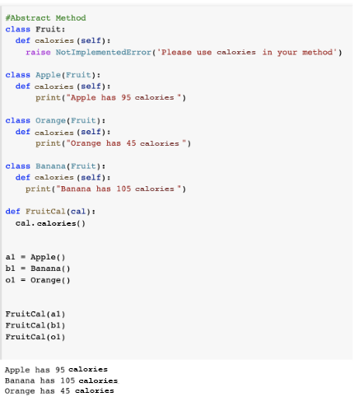
Polymorphism
What is Polymorphism?
Poly = many.
Morphism = different from.

Slide 4
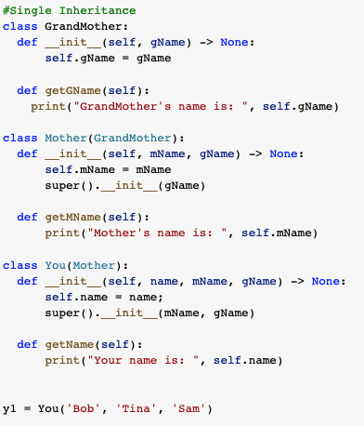
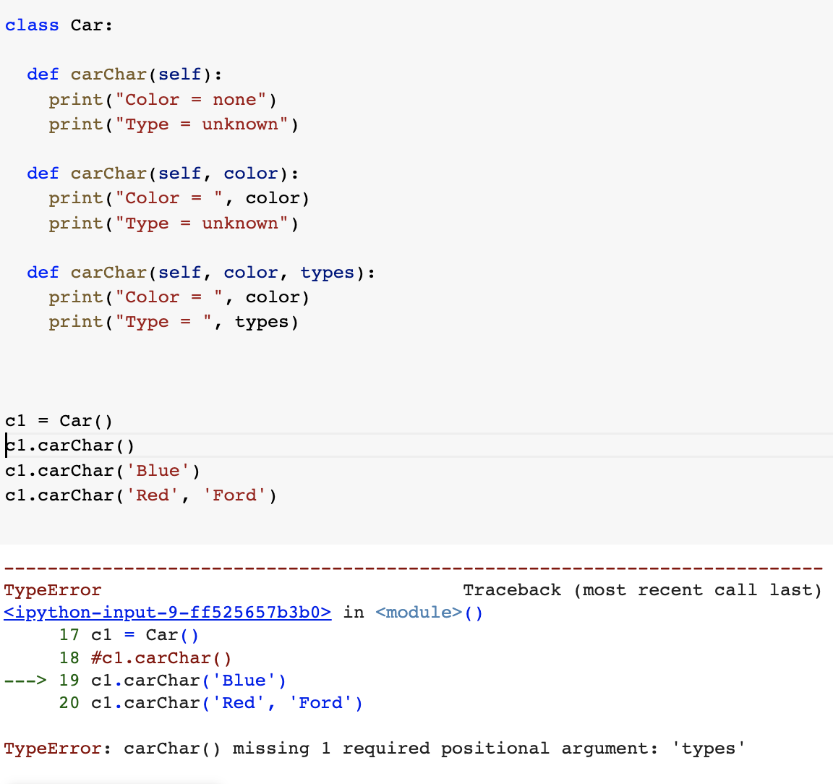
Polymorphism
Polymorphism
Overloading.
Parameters.
Overriding.
Super.

Slide 5
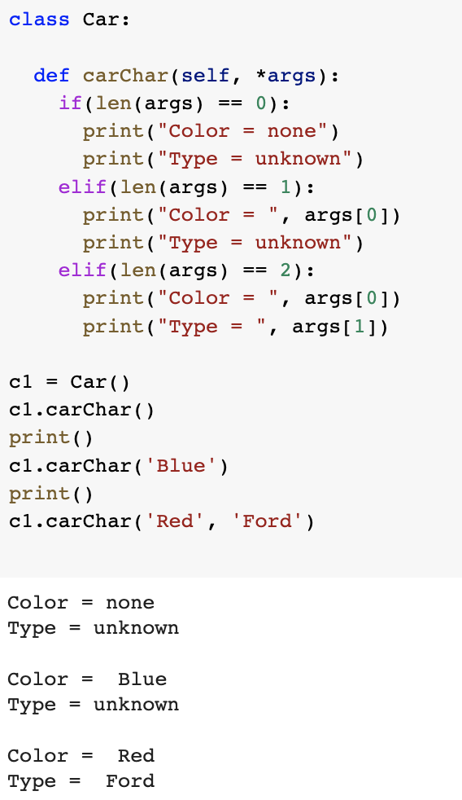
Polymorphism
Polymorphism
Overriding.

Slide 6
Demo

